Slide 1
Chapter Two
Utility
效用

Slide 2
Structure
Utility function (效用函数）
  Definition
  Monotonic transformation （单调转换）
  Examples of utility functions and their indifference curves
Marginal utility （边际效用）
Marginal rate of substitution 边际替代率
  MRS after monotonic transformation

Slide 3
Utility Functions
A utility function U(x) represents a preference relation if and only if:
x’ ≻ x” U(x’) > U(x”)
x’ ≿ x” U(x’) ≥ U(x”)
x’ ∼ x” U(x’) = U(x”).

Slide 4
Utility Functions
Utility is an ordinal (i.e. ordering) concept. [序数效用]
E.g. if U(x) = 6 and U(y) = 2 then bundle x is strictly preferred to bundle y. But x is not preferred three times as much as is y.

Slide 5
Utility Functions & Indiff. Curves
Consider the bundles (4,1), (2,3) and (2,2).
Suppose (2,3) ≻ (4,1) ∼ (2,2).
Assign to these bundles any numbers that preserve the preference ordering;
e.g. U(2,3) = 6 > U(4,1) = U(2,2) = 4.
Call these numbers utility levels.

Slide 6
Utility Functions & Indiff. Curves
An indifference curve contains equally preferred bundles.
Equal preference ⇒ same utility level.
Therefore, all bundles in an indifference curve have the same utility level.

Slide 7
Utility Functions & Indiff. Curves
So the bundles (4,1) and (2,2) are in the indiff. curve with utility level U ≡ 4
But the bundle (2,3) is in the indiff. curve with utility level U ≡ 6.
On an indifference curve diagram, this preference information looks as follows:

Slide 8
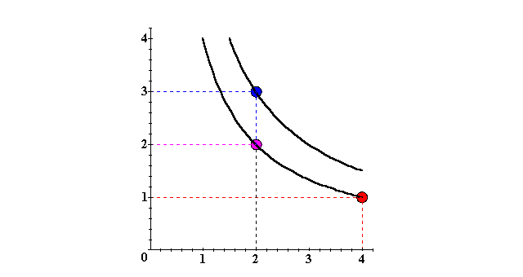
Utility Functions & Indiff. Curves
x₂
(2,3) ≻ (2,2) ∼ (4,1)
U ≡ 6
U ≡ 4
x₁

Slide 9
Utility Functions & Indiff. Curves
Comparing more bundles will create a larger collection of all indifference curves and a better description of the consumer’s preferences.

Slide 10
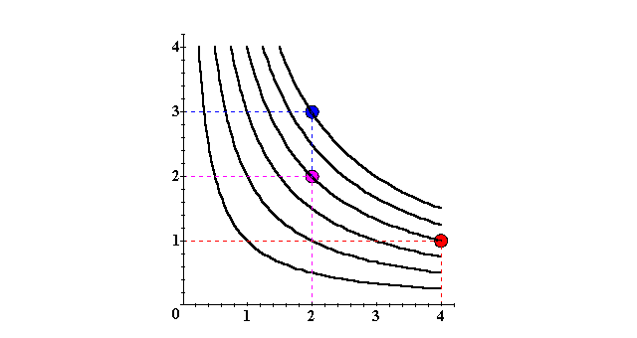
Utility Functions & Indiff. Curves
x₂
U ≡ 6
U ≡ 4
U ≡ 2
x₁

Slide 11
Utility Functions & Indiff. Curves
The collection of all indifference curves for a given preference relation is an indifference map.
An indifference map is equivalent to a utility function; each is the other.

Slide 12
Utility Functions
There is no unique utility function representation of a preference relation.
Suppose U(x₁,x₂) = x₁x₂ represents a preference relation.
Again consider the bundles (4,1),
(2,3) and (2,2).

Slide 13
Utility Functions
U(x₁,x₂) = x₁x₂, so
U(2,3) = 6 > U(4,1) = U(2,2) = 4;
that is, (2,3) ≻ (4,1) ∼ (2,2).

Slide 14
Utility Functions
U(x₁,x₂) = x₁x₂ (2,3) ≻ (4,1) ∼ (2,2).
Define V = U².
Then V(x₁,x₂) = x₁²x₂² and
V(2,3) = 36 > V(4,1) = V(2,2) = 16
so again
(2,3) ≻ (4,1) ∼ (2,2).
V preserves the same order as U and so represents the same preferences.

Slide 15
Utility Functions
U(x₁,x₂) = x₁x₂ (2,3) ≻ (4,1) ∼ (2,2).
Define W = 2U + 10.

Slide 16
Utility Functions
U(x₁,x₂) = x₁x₂ (2,3) ≻ (4,1) ∼ (2,2).
Define W = 2U + 10.
Then W(x₁,x₂) = 2x₁x₂+10 so
W(2,3) = 22 > W(4,1) = W(2,2) = 18. Again,
(2,3) ≻ (4,1) ∼ (2,2).
W preserves the same order as U and V and so represents the same preferences.

Slide 17
Utility Functions: Monotonic Transformation
If
  U is a utility function that represents a preference relation and
  f is a strictly increasing function,
then V = f(U) is also a utility function
representing the preference relation.

Slide 18
Goods, Bads and Neutrals
A good is a commodity unit which increases utility.
A bad is a commodity unit which decreases utility.
A neutral is a commodity unit which does not change utility (gives an equally preferred bundle).

Slide 19
Goods, Bads and Neutrals
Utility
Utility
function
Units of
water are
goods
Units of
water are
bads
x’
Water
Around x’ units, a little extra water is a neutral.

Slide 20
Some Other Utility Functions and Their Indifference Curves
Perfect substitute
  V(x₁,x₂) = x₁ + x₂.
Perfect complement
  W(x₁,x₂) = min{x₁,x₂}
Quasi-linear
  U(x₁,x₂) = f(x₁) + x₂
Cobb-Douglas Utility Function
  U(x₁,x₂) = x₁ª x₂^{b}
What do the indifference curves for these utility functions look like?

Slide 21
Perfect Substitution Indifference Curves
x₂
x₁ + x₂ = 5
13
x₁ + x₂ = 9
9
x₁ + x₂ = 13
5
V(x₁,x₂) = x₁ + x₂.
5
9
13
x₁
All are linear and parallel.

Slide 22
Perfect Complementarity Indifference Curves
x₂
45º
W(x₁,x₂) = min{x₁,x₂}
8
min{x₁,x₂} = 8
5
min{x₁,x₂} = 5
3
min{x₁,x₂} = 3
3
5
8
x₁
All are right-angled with vertices on a ray
from the origin.

Slide 23
Quasi-Linear Utility Functions
A utility function of the form
U(x₁,x₂) = f(x₁) + x₂
is linear in just x₂ and is called quasi-linear （准线性）.
E.g. U(x₁,x₂) = 2x₁^{1/2} + x₂.

Slide 24
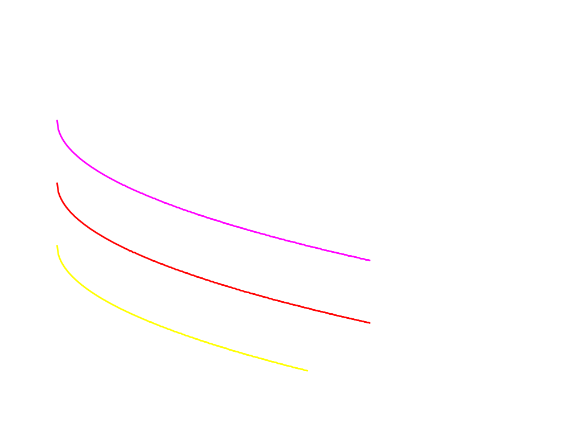
Quasi-linear Indifference Curves
x₂
Each curve is a vertically shifted copy of the others.
x₁

Slide 25
Cobb-Douglas Utility Function
Any utility function of the form
U(x₁,x₂) = x₁ª x₂^{b}
with a > 0 and b > 0 is called a Cobb-Douglas utility function.
E.g. U(x₁,x₂) = x₁^{1/2} x₂^{1/2} (a = b = 1/2)
V(x₁,x₂) = x₁ x₂³ (a = 1, b = 3)

Slide 26
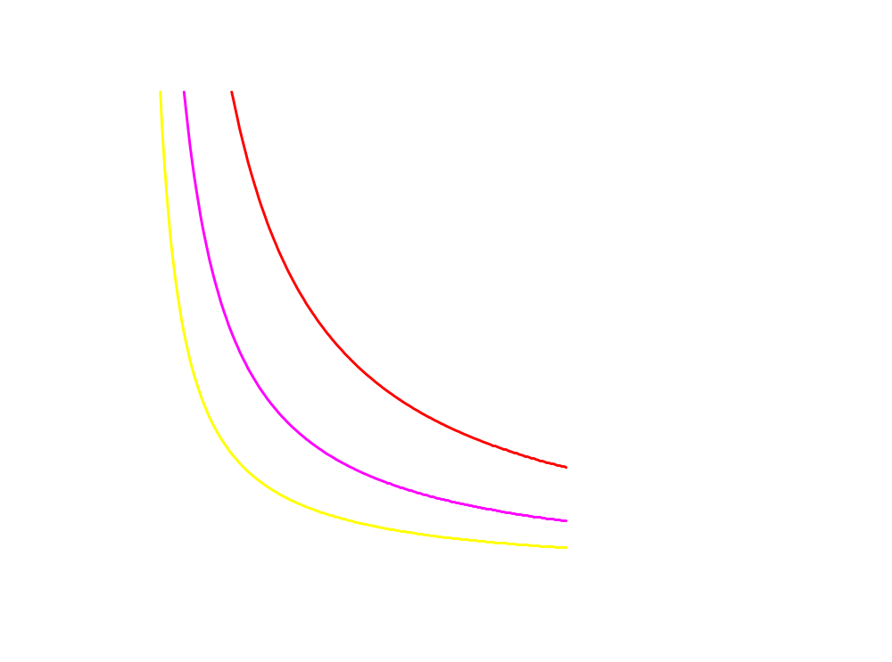
Cobb-Douglas Indifference Curves
x₂
x₁

Slide 27
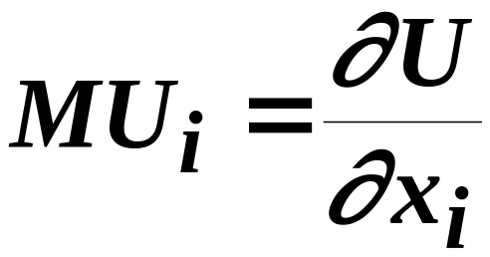
Marginal Utilities
Marginal means “incremental”.
The marginal utility of commodity i is the rate-of-change of total utility as the quantity of commodity i consumed changes; i.e.

Slide 28
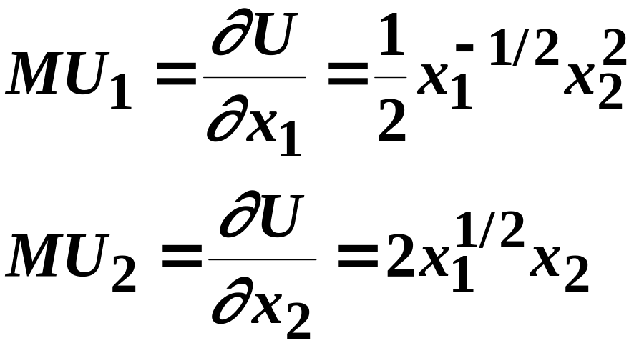
Marginal Utilities
If U(x₁,x₂) = x₁^{1/2} x₂² then

Slide 29
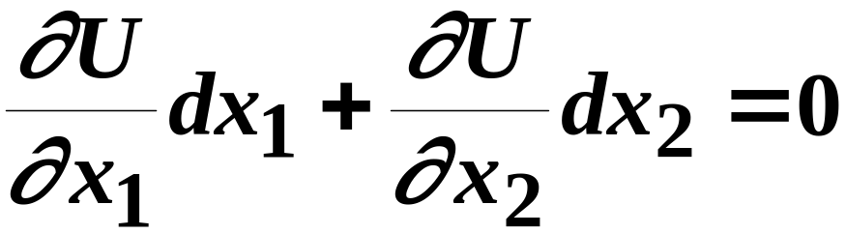
Marginal Utilities and Marginal Rates-of-Substitution
The general equation for an indifference curve is
U(x₁,x₂) ≡ k, a constant.
Totally differentiating this identity gives

Slide 30
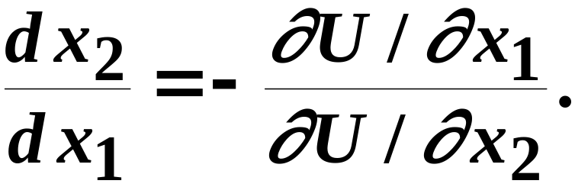
Marginal Utilities and Marginal Rates-of-Substitution
rearranged is
This is the MRS.

Slide 31
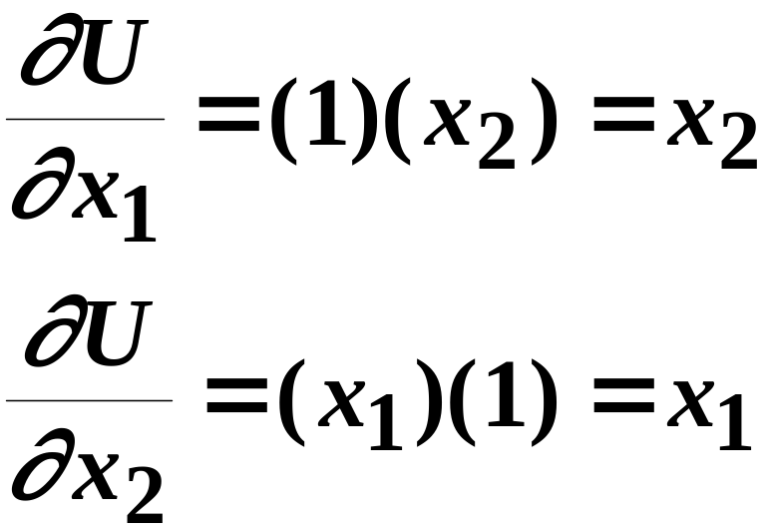
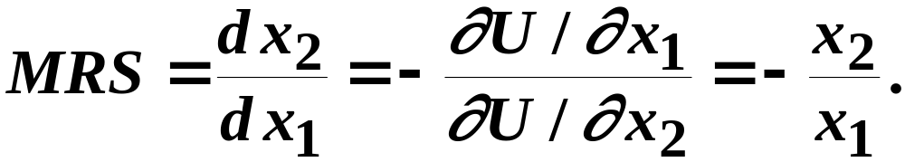
Marg. Utilities & Marg. Rates-of-Substitution; An example
Suppose U(x₁,x₂) = x₁x₂. Then
so

Slide 32
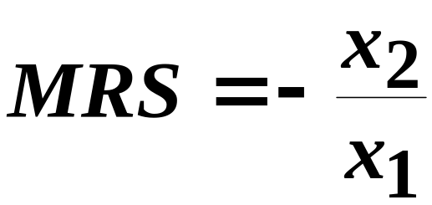
Marg. Utilities & Marg. Rates-of-Substitution; An example
U(x₁,x₂) = x₁x₂;
x₂
8
MRS(1,8) = - 8/1 = -8
MRS(6,6) = - 6/6 = -1.
6
U = 36
U = 8
1
6
x₁

Slide 33
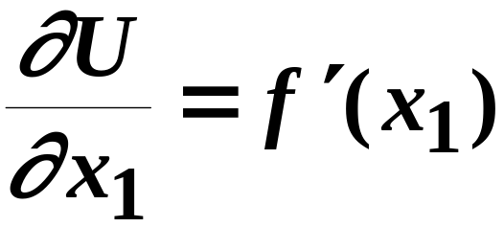
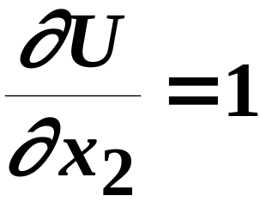
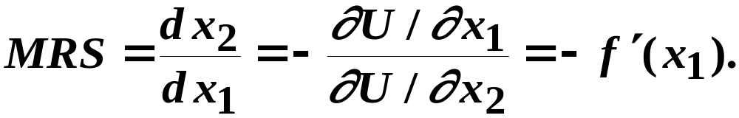
Marg. Rates-of-Substitution for Quasi-linear Utility Functions
A quasi-linear utility function is of the form U(x₁,x₂) = f(x₁) + x₂.
so

Slide 34
Marg. Rates-of-Substitution for Quasi-linear Utility Functions
x₂
MRS =
- f(x₁’)
MRS = - f (x₁) does not depend upon x_{2.}
MRS = -f(x₁”)
MRS is a constant
along any line for which x₁ is
constant.
x₁’
x₁”
x₁

Slide 35
Monotonic Transformations & Marginal Rates-of-Substitution
Applying a monotonic transformation to a utility function representing a preference relation simply creates another utility function representing the same preference relation.
What happens to marginal rates-of-substitution when a monotonic transformation is applied?

Slide 36
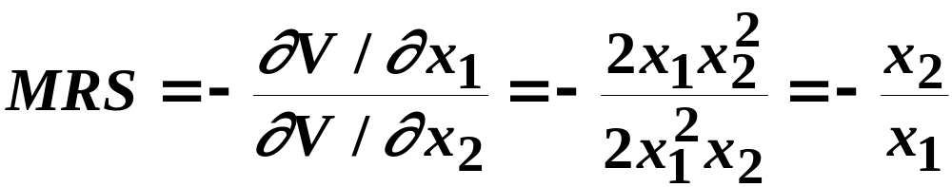
Monotonic Transformations & Marginal Rates-of-Substitution
For U(x₁,x₂) = x₁x₂ the MRS = - x₂/x₁.
Create V = U²; i.e. V(x₁,x₂) = x₁²x₂². What is the MRS for V?
which is the same as the MRS for U.

Slide 37
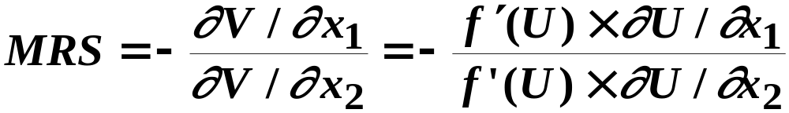
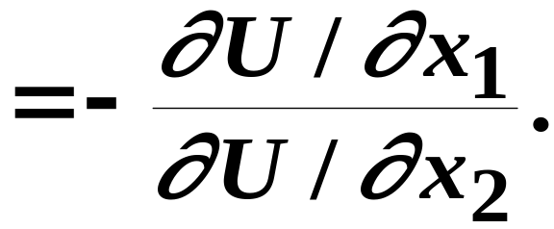
Monotonic Transformations & Marginal Rates-of-Substitution
More generally, if V = f(U) where f is a strictly increasing function, then
So MRS is unchanged by a positive
monotonic transformation.

